Slide 1

Android Multimedia Overview
February 11th 2009
David Gottardo, System SW Architecture at Texas Instruments France
Email: d-gottardo@ti.com

Slide 2
Android Architecture
Table of Contents
Audio Flinger: Audio manager
Surface Flinger: Surface manager / composite
Multimedia Framework
  MM Playback
  (MM Record)

Slide 3
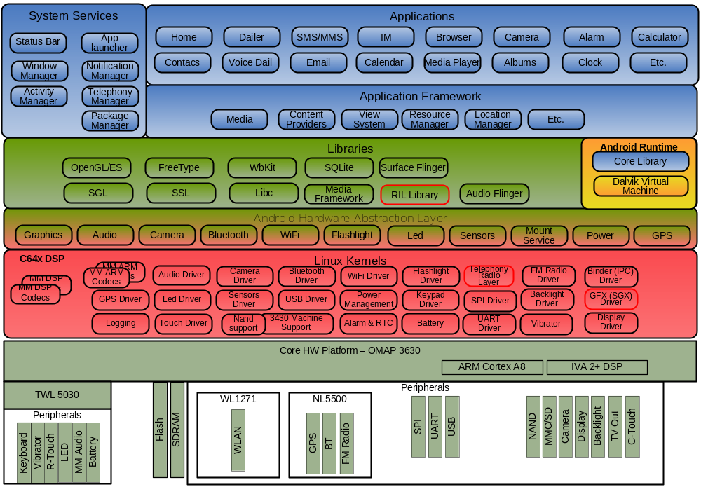
Android Components
Red border is corresponding to components not supported by TI SW foundation (Modem vendors, etc.)

Slide 4
Android Surface Manager

Slide 5
Client/Server Architecture
Android graphics system is based on a Client/Server Architecture
Server side: Surface Flinger is a service coded in C++
  Manages access to display subsystem
  Seamlessly composites 2D and 3D graphic layers from multiple applications
Client side: applications can draw on surfaces using two paths:
  Use widgets/View/Canvas provided by the JAVA APIs and managed by C++ external Skia library
  Access OpenGL through JNI to directly create 3D surfaces
2D Apps / 3D Apps
Java View/
Widget/
Canvas
Java Native Interface
SKIA (SGL)
OpenGL
Surface

Slide 6
SurfaceFlinger
Server side native library (C++): frameworks/base/libs/surfaceflinger/
Provides system-wide surface “composer”, handling all surface rendering to frame buffer device.
Can combine 2D and 3D surfaces (Z-buffer) from multiple Applications
Can use OpenGL ES and 2D hardware accelerator for its compositions.
Double-buffering using page-flip.
Surfaces passed as buffers via Binder IPC calls (Android’s interprocess communication pipe).
2D Surface
3D Surface
3D Surface
SurfaceFlinger
(libsurfaceflinger)
OpenGL ES (HW or SW)
Frame
Buffer

Slide 7
Surface Management
Android apps are built using View and ViewGroup objects:
  Basic UI building blocks (text, buttons, checkboxes, etc)
  Responsible for handling drawing, events, measuing.
Each View is tied to a Surface, which is double buffered.
Surfaces are managed as follows:
  ViewRoot (app window) asks SurfaceFlinger for Canvas for View to draw on.
  View draws its data on the Canvas.
  ViewRoot calls surface.unlockCanvasAndPost(canvas) to schedule surfaceFlinger::composeSurfaces()
  SurfaceFlinger::composeSurfaces() does actual display on panel.
  SurfaceFlinger handles transfer of drawn data in canvas to surface front buffer or backbuffer.
  Surface Interface: framework/base/include/ui/ISurface.h
  Surface management: framework/base/view/surface.java

Slide 8
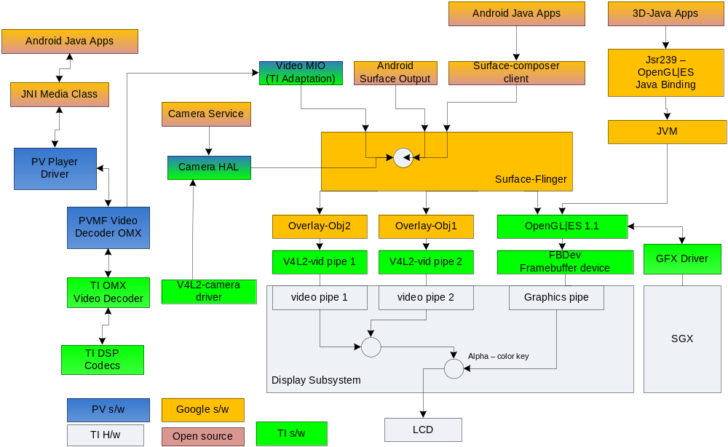
Android Graphics System
SurfaceFlinger Architecture

Slide 9
Android
Audio Framework

Slide 10
Android Multimedia
AudioFlinger Architecture
Manages all audio output devices
Processes multiple audio streams into PCM audio out paths
Handles audio routing to various outputs
Available in: libs/external/audioFlinger
HAL available in: hardware/alsa_sound/AudioHardwareALSA.h
Tone
Audio
Audio
Flinger
Earpeace
APP
Media
Player
Speaker
APP
Game
Audio
Bluetooth

Slide 11
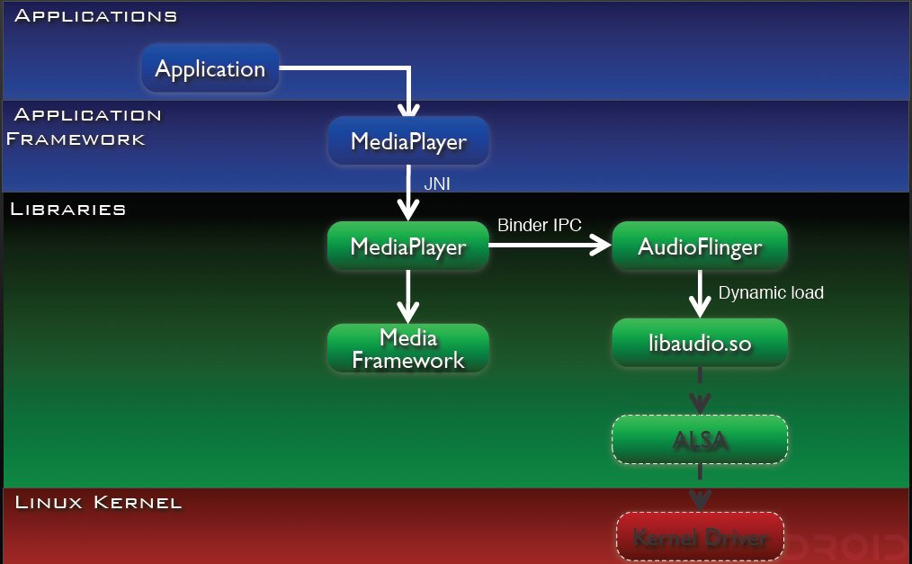
Android Multimedia
Audio Flinger Interaction Layer

Slide 12
Android Multimedia
Audio Architecture overview
UI
Java code
Start Stream
(openTrack)
AudioTrack.java
./frameworks/base/media/java/android/media/AudioTrack.java
Streams
AudioFlinger.cpp
Audio Policy Service
Audio Policy
AudioPolicyManagerALSA.cpp
IN
OUT
ALSA Audio HAL
Minor changes
applied for Éclair by FMA
./hardware/alsa_sound
OMAP3 ALSA lib
Most of changes
applied for Éclair by FMA
./ti/omap3/modules/alsa
ALSA lib
Kernel

Slide 13
Android Multimedia
Audio Framework Components
Stream: digital bits that represent a sound
  Stream VOICE_CALL (used for Voice record)
  Stream SYSTEM (for system sounds)
  Stream RING
  Stream MUSIC
  Stream ALARM
  Stream NOTIFICATION
Audio Flinger: mixer (mix sound, adjust soft volumes, …): take several streams, mix them + apply volume on each stream. These streams are entering (IN’s stream) or outputing (OUT’s stream).
OUT’s & IN’s are physical HW channels
These OUT’s & IN’s are attached to devices.
Device= headset, handset, …
Streams are grouped into strategy
Strategy:
  Phone: VOICE_CALL, BT_SCO
  Sonification: RING, NOTIFICATION, ALARM
  ENFORCE_ENABLED: unmutable strings (exple: in some country it is mandatory to produce a sound when recording with a camera )

Slide 14
Android Multimedia
Audio HAL
HAL definition:
  Interface: AudioHardwareInterface.h
  Stub version of the HAL is located into the framework directory:
  framework/base/libs/audioflinger/AudioHardwareStub.h
Platform implementation is located into hardware directory:
  TI HAL solution (depreciated): hardware/omap3/libaudio/audioHardwareOmap.cpp
  ALSA HAL solution (in used): hardware/alsa_sound/AndroidHardwareAlsa.cpp

Slide 15
Android Multimedia

Slide 16
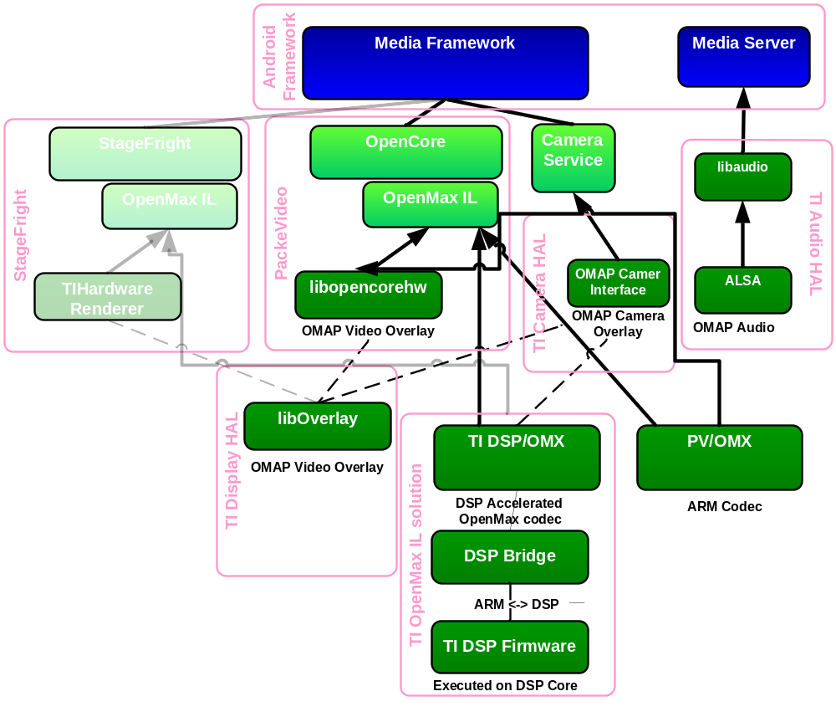
Android Multimedia
Components Diagram

Slide 17
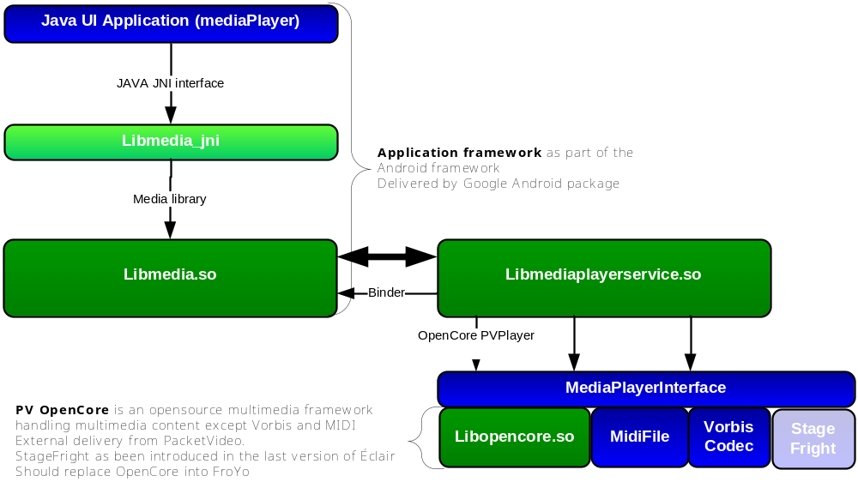
Android Multimedia
Android stack overview

Slide 18
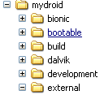
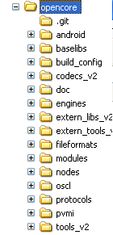
Android Architecture
OpenCore external library
Based on PacketVideo OpenCORE platform
  OpenCORE is based on the commercial CORE of ParcketVideo
  for Android. This framework is Open source. http://www.pv.com/products/android/index.html
  Large documentation into opencore/doc directory
Supports standard video, audio, still-frame formats
  Non optimized reference codec available in opencore/codecs_v2
Support for hardware / software codec plug-ins using OMX
  Openmax headers available in external_libs_v2

Slide 19
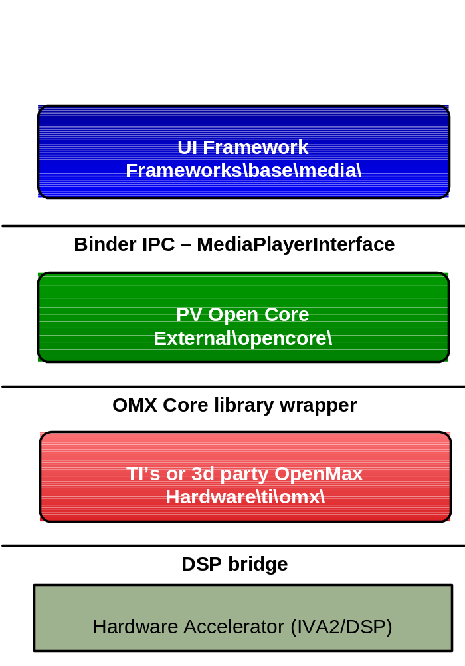
Android stack overview
Application framework as part of the Android framework
Delivered by Google Android package
(mainly in C++)
PV OpenCore is an opensource multimedia framework handle multimedia content except Vorbis and MIDI
External delivery from PacketVideo
TI OMX implementation to support the IVA2/C64x DSP.
Part of the hardware specific implementation from TI

Slide 20
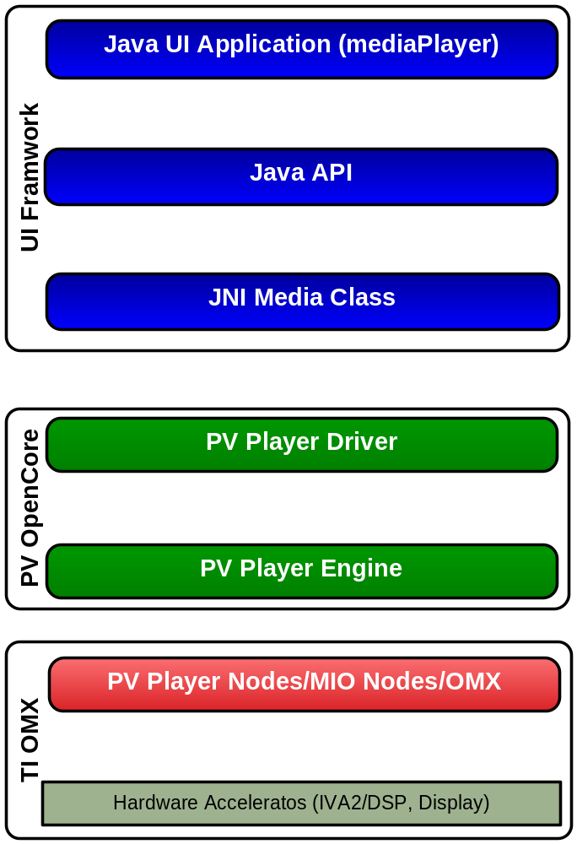
Android Multimedia
Android AV Playback layers
Third-party Video Player develop under JAVA
On Android there is two classes (MediaPlayer and VideoView) provide support to the video player (VideoView based on MediaPlayer)
framework\media\java\android\media\MediaPlayer.java
Native Java Interface Layer. Allow JAVA APIs access to the native libraries (C++)
JNI:framework\media\java\android\media\JNI\android_media_MediaPlayer.cpp
Implementation:framework\media\java\android\media\libmedia\MediaPlayer.cpp
Load all necessary libraries for pvplayer and creates the proper MIO Nodes that will interact with the platform specific HW
external\opencorejava\android\playerdriver.cpp
PVPlayer creates and configure the required nodes involved on the AV Playback pipeline so they can interact with each other then it will oversee the operation of the pipeline.
PV node wrap software or hardware codecs and they can sink or source of data. The MIO nodes contain glue code between the Video Pipeline and the HW (e.g. methods to send buffers to the Display)

Slide 21
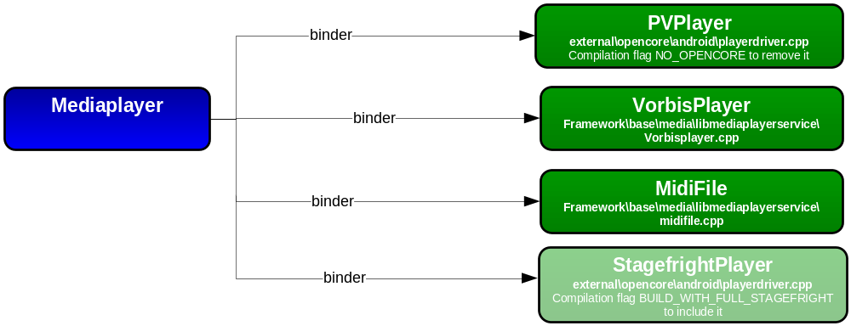
Android Multimedia
Media Player Service
Responsibility:
Provide mediaplayer services to the application framework (MediaPlayer) through the IPC binder.
Create a proper playerdriver to handle the input stream.
The MediaPlayerService supports 4 players:
Create the connection between the MediaPlayer (framework process) and the new playerdriver (service process)
Manage the audio ( output to the audio framework /Audio cache)
MediaPlayer C++ class interface with the IMediaPlayerService service through binder IPC

Slide 22
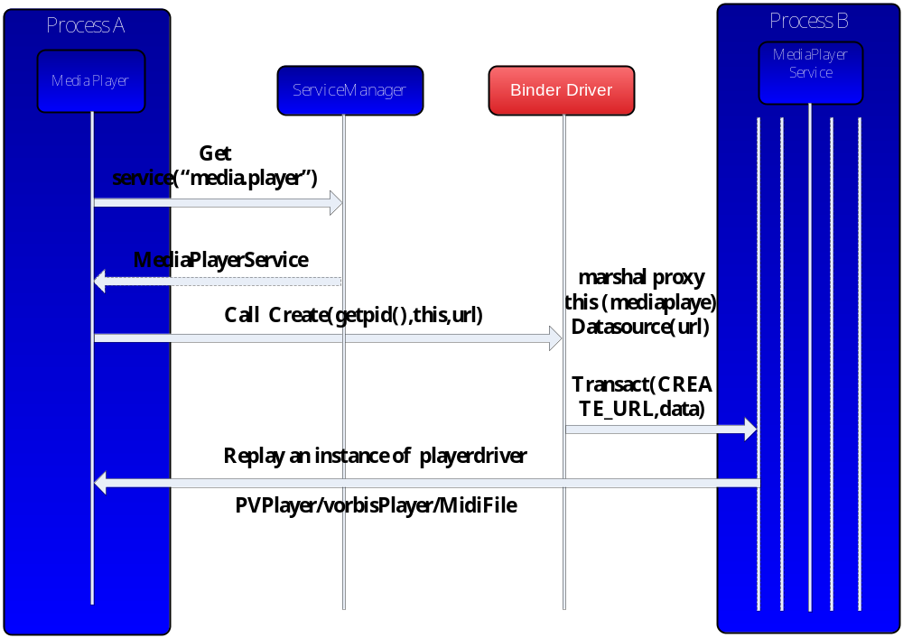
Android Multimedia
Player Driver Creation

Slide 23
Android Multimedia
Player Driver
process/service name: media.player (dumpsys media.player)
Interface: android.hardware.IMediaPlayer
Definition: iMediaPlayer.h
  Binder proxy: BpMediaPlayer (iMediaPlayer.cpp)
    perform the interface calls through the IPC (application process side)
  Binder native: BnMediaPlayer Stub of BnMediaPlayerService (MediaPlayerService.cpp)
    Implement the interface (service process side)
    Stub as from BnMediaPlayerService s running into the same process
status_t start() {
Parcel data, reply;
data.writeInterfaceToken(IMediaPlayer::getInterfaceDescriptor());
emote()->transact(START, data, &reply);
return reply.readInt32(); }
onTransact(
reply->writeInt32(start());

Slide 24
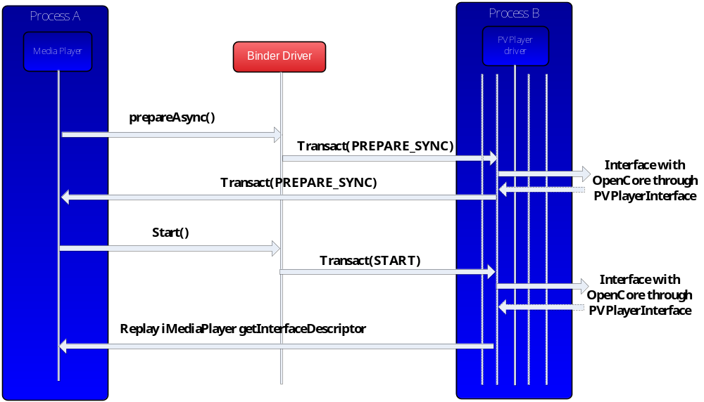
Android Multimedia
Media Player Driver

Slide 25
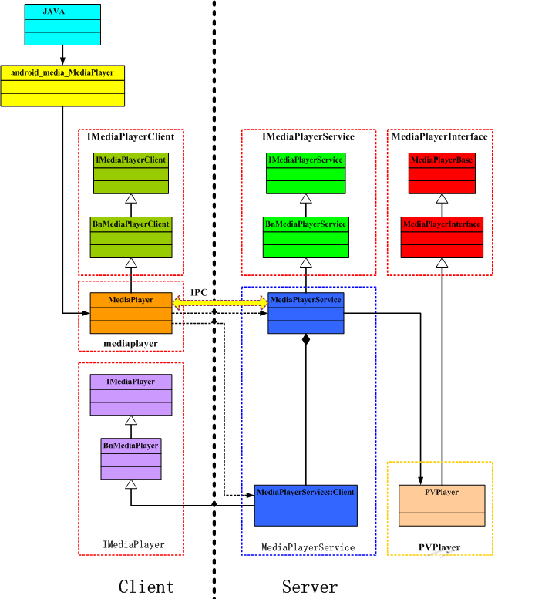
Android Multimedia
Media Player Service UML
1
Binder : Retrieve appropriate Player
2
Binder: Abstract the player Control
3
OpenCore interface: Abstract PV Engine
1
3
2

Slide 26
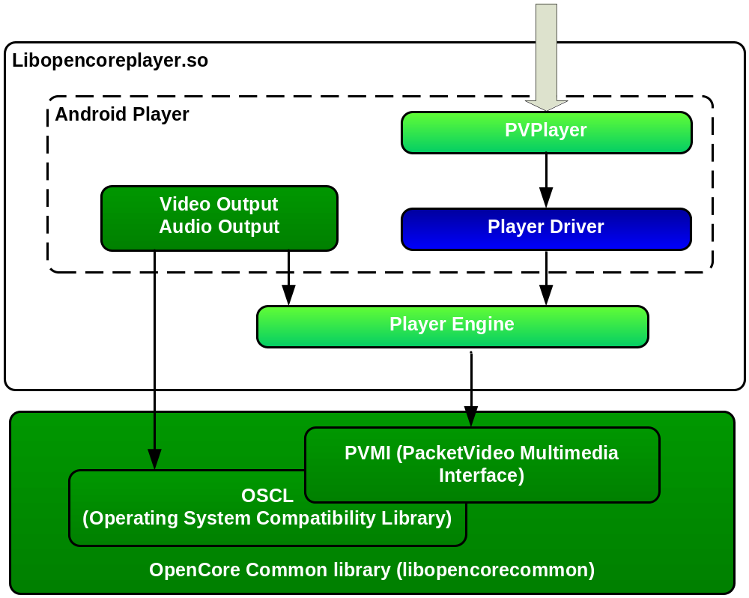
Android Multimedia
Android OpenCore Player

Slide 27
Android Multimedia
OpenCore PVPlayer
Wrapper between Android and OpenCore:
  Implement binder android.hardware.IMediaPlayer interface for UI framework connection
  Support a playerdriver object (mPlayerDriver) to interface with OpenCore (PV Player Engine)
header: frameworks\base\include\media\PVPlayer.h
Implementation: external\openCore\android\playerdriver.cpp

Slide 28
Android Multimedia
OpenCore PlayerDriver
Interface with the PVPlayer Engine:
Support PVPlayerInterface: Asynchronous and Synchronous commands send to PVPlayer Engine (PlayerCommand)
Implement callback for event handeling called by PVPlayer Engine (PVCommandStatusObserver,PVInformationalEventObserver, PVErrorEventObserver OpenCore interfaces)
Header/Implementation: external\openCore\android\playerdriver.cpp
Commands definition/implementation: external\openCore\android\playerdriver.h

Slide 29
Android Multimedia
OpenCore PVPlayer Engine
Heart of PVPlayer:
  receives and processes requests from playerDriver
  manages the PVMF components required for multimedia playback and related operations.
Define the PVPlayerInterface to allow PlayerDrivers to interface with
Process PlayerDriver commands initiated by API calls asynchronously.
Notify the PlayerDriver from events coming from PVMF
Maintains a state machine modified based on PVPlayerInterface APIs called and events from PVMF components below
Header: external\openCore\engines\player\include\pv_player_interface.h
Implementation: external\openCore\engines\player\src\pv_player_interface.cpp

Slide 30
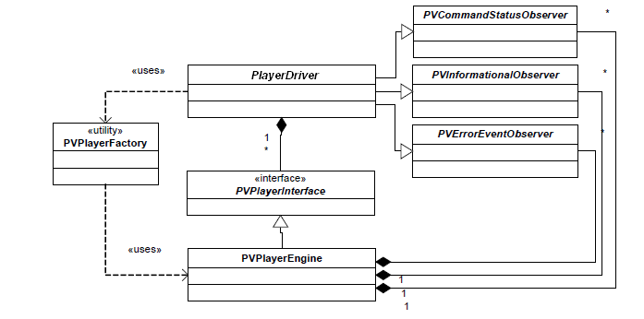
Android Multimedia
PVPlayer Engine Class Diagram

Slide 31
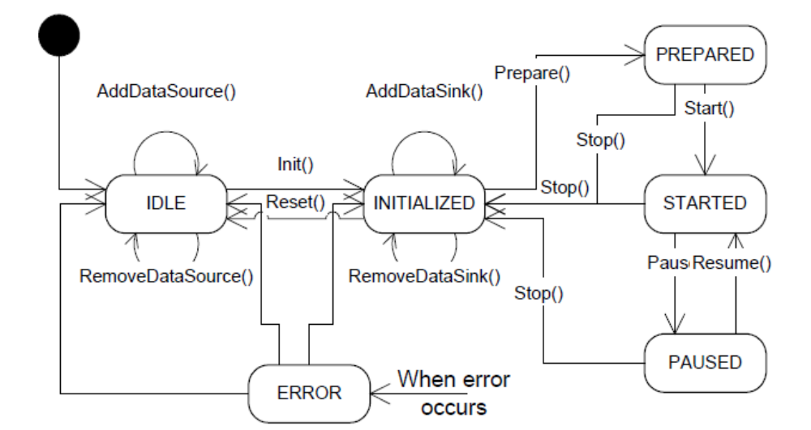
Android Multimedia
PVPlayer Engine State Transition Diagram

Slide 32
Android Multimedia
OSCL (Operating System Compatibility Library)
OSCL abstracting the HLOS dependencies to manage:
  Thread (osclproc directory)
  memory (osclmemory directory)
  file/socket (osclio directory),
  etc…
OSCL directory: external/opencore/oscl/
Documentation: external/opencore/doc/oscl_html

Slide 33
Android Multimedia
PVMI(PacketVideo Multimedia Interface)
1) PVMF is the OpenCore multimedia framework:
Define the multimedia architecture upon which the PVPlayer engine is based
Define Nodes (based on OSCL) to manage:
  files Nodes Responsible to parse media file (mp3, avi)
    Nodes available in: in external/opencore/nodes
    Parser available in: external/opencore/fileformats
  OMX Nodes to communicate with OMX layers
    Encoder: external/opencore/nodes/pvomxaudiodecnode/
    Decoder: external/opencore/nodes/pvomxvideodecnode/
PVMF directory: external/opencore/pvmi
2) Provide MIO (Media I/O) interfaces
  Files MIO: external/opencore/pvmi/media_io
  Android Specific for Surface, Camera, Audio MIO:external/opencore/android/
No specific documentation

Slide 34
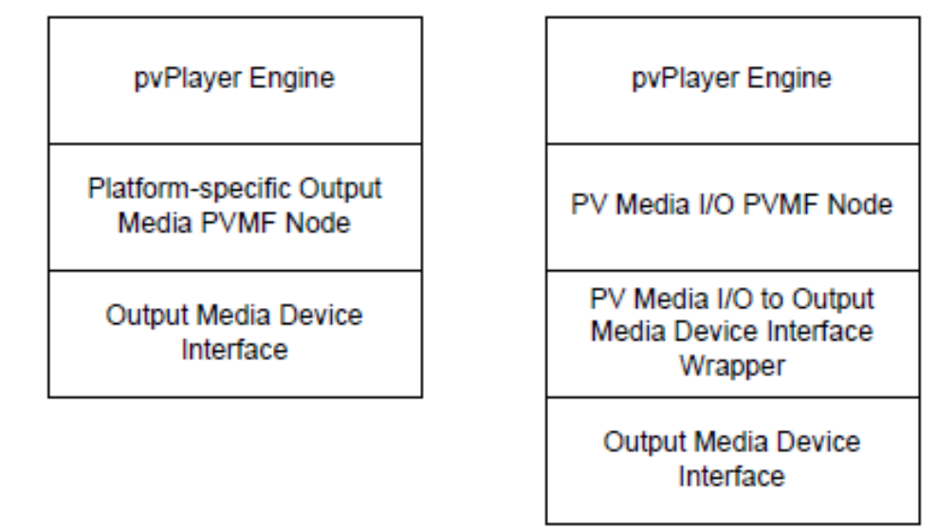
Android Multimedia
Media Output to Node and Media I/O
2 methods for PVPlayer Engine handles interfacing to platform specific output media devices :
  Encapsulate the media device in a PVMF node which PVPlayer Engine can use directly.
      This method minimizes the code between PVPlayerEngine and the media device interface.
  Interface the media device to PV’s Media I/O interface.
    PVPlayer Engine can use the PVMF node that interfaces PV Media IO to output

Slide 35
Android Multimedia
PVMI Component Diagram (Decode path)
PVPlayer Engine
media input node
Master Core
OMX Core
Opensource
Opencore
PVMI
Parser Node
Google
Packet Video
omx audio/video dec node
TI SW
MM decoder
MIO Output PVMF Node
Hardware
TI OMX
surfaceflinger
audioflinger
DisplayHardwareInterface
AudioHardwareInterface
Display
Speaker

Slide 36
Android Multimedia
PVMI Component Diagram (Record path)
Record Applications
media output node
Master Core
OMX Core
Opensource
Muxer Node
Google
opencore
Display
Packet Video
omx audio/video enc node
MM Encoder
TI SW
Display
Hardware
Interface
media Input node
Hardware
TI OMX
surfaceflinger
Camera Service
Camera HAL
audioflinger
CameraHardwareInterface
AudioHardwareInterface
Camera
Microphone

Slide 37
Android Multimedia
OpenMax Definition
Definition:
  OpenMAX is a royalty-free, cross-platform API that provides
  abstractions for routines especially useful for computer graphics,video, and audio.
  Website: http://www.khronos.org/openmax/
OpenMAX AL (Application Layer)
  Audio/Video/Image Playback/Recording
OpenMAX IL (Integration Layer)
  Blocks of functionality: sources, sinks, filters, etc.
OpenMAX DL (Development Layer)
  Low-level building blocks: DCT, LoopFilter, Quantization, etc..

Slide 38
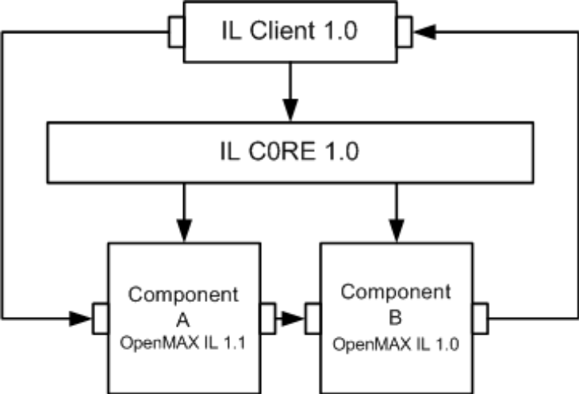
Android Multimedia
OpenMax IL Overview
OpenMax IL API is a component-based media API
Consists of two main segments:
  Core API (unique component):
    Dynamic loading/unloading components management
    Facilitating component communication (Tunneling)
  Component API (several components):
    Individual blocks of functionality
    Can be source, sink, codecs, filters, splitters, mixers, etc..

Slide 39
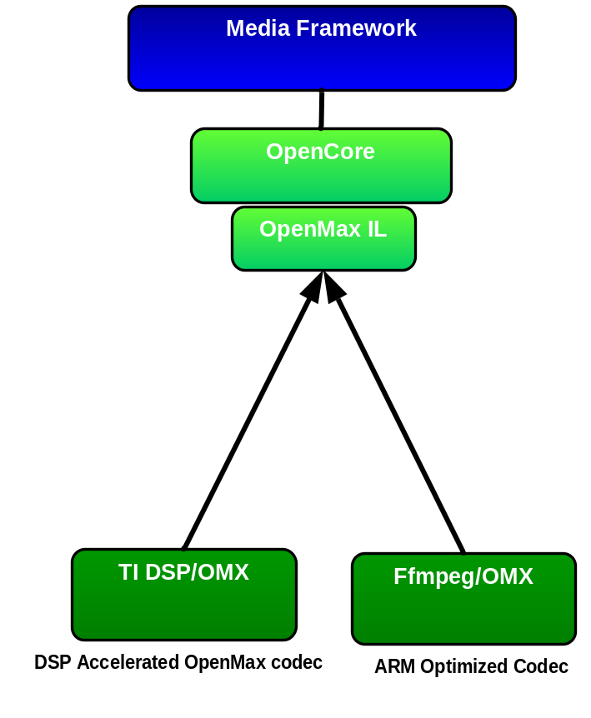
Android Multimedia
OpenMax IL into OpenCore
Master Core: OpenCore support several OMX vendors solutions:
  method of dynamic loading/linking of multiple OMX cores
  OMX core methods called through a thin wrapper layer (mastercore):external/openCore/codecs_v2/omx/omx_common/src/pv_omxmastercore.cpp
  Avoid co-existence of multiple OMX cores issues
  Maintain a cross-vendors OMX component registry
  Interface
PV OpenCore provides an implementation of PV OMX core and PV OMX components in external/openCore/codecs_v2/omx/
OpenCore framework behaves as OpenMax IL client when it communicates with Vendors OMX core.
OpenCore PVMF OMX Nodes:
  Wrapper between the PVPlayer Engine and the OMX components
  Directory:external/openCore/nodes/pvomxencnode
  Directory:external/openCore/nodes/pvomxvideodecnode
  Directory:external/openCore/nodes/pvomxdecnode
  Directory:external/openCore/nodes/pvomxbasedecnode

Slide 40
Android Multimedia
OpenMax IL Master Core
Avoid co-existence of multiple OMX cores issues:
  Maintain a cross-vendors OMX component registry
  Method of dynamic loading/linking of multiple OMX cores
Define “OMXInterface” Interface to be implemented by OMX Core vendors
Implementation:external/openCore/codecs_v2/omx/omx_common/src/pv_omxmastercore.cpp
Interface definition:
external/openCore/codecs_v2/omx/omx_common/include/omx_interface.h
Documentation:
external/openCore/doc/omx_core_integration_guide.pdf

Slide 41
Android Multimedia
OpenCore OMX Master Core
Component query by role from Client
opencore player – decode
opencore author – encode
opencore common
  PV master core
  OMX master registry
  Vendor OMX Core wrappers
master core
master core
component registry
TI core wrapper
PV core wrapper
OMX.TI.AAC.decode
OMX.TI.XYZ.decode
OMX Core
OMX Core
OMX.TI.AAC.decode
OMX.PV.aacdecode
Other vendor OMX?
First match?

Slide 42
Android Multimedia
TI OpenMax IL Solution
TI OpenMax IL is a DSP based solution.
TI OMX Core: hardware/ti/omx/core_plugin/omx_core_pluging/src/ti_omx-interface.cpp
TI OMX Components:
  hardware/ti/omx/[audio,video,imaging]
  Interface with the DSP SocketNode through the Bridge
DSP Components:
  DSP baseimage including the algorithm/SocketNodes/bridge/bios are loaded by android init process (init.rc)
  The ARM Bridge is loaded as part of the Linux kernel

Slide 43
Android Multimedia
TI OpenMax IL Solution
Master OMX Core
PVMF media input node
PVMF Parser node
PVMF OMX audio/video decoder nodes
PVMF media output node
SurfaceFlinger
Video Hardware Interface
PV OpenCore
OMX Core
AudioFlinger
Audio Hardware Interface
AAC Decoder
OpenMAX Component
MPEG Video Decoder
OpenMAX Component
LCML
TI OMX
ARM
MPU Bridge
DSP
DSP Bridge
USN
AAC Decoder
Socket Node
MPEG Video Dec
Socket Node
External Component
AAC Decoder
Algorithm
MPEG Video Dec
Algorithm
TI MM Component

Slide 44
Android Multimedia
TI OpenMax IL Solution
Algorithm
  XDM/XDAIS compliant. Runs on DSP/BIOS.
Socket Node
  Algorithm-specific preparation around the algo’s process() call
  TCONF file specifies memory requirement for various codec profiles
USN
  Generic data & control processing, including DSP cache coherency operations
Bridge
  Loads DSP baseimage and dlls. Manage DSP nodes. DSP Power Management.
  Map/unmap buffers. Implements ARM cache coherency APIs.
LCML
  Performs common data & control processing for OMX components.
  Groups together several Bridge API calls into one. Serves as Bridge abstraction.
OMX
  Implements standard OpenMAX interfaces for integration with HLOS MM Framework
  Android/PV Master OMX framework is in C++, whereas TI’s code is in C

Slide 45
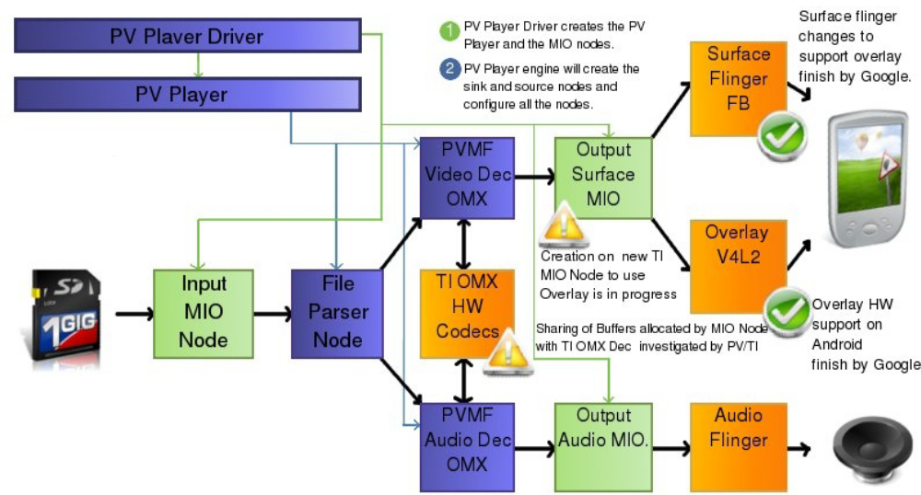
Android Multimedia
Create of AV playback pipeline

Slide 46
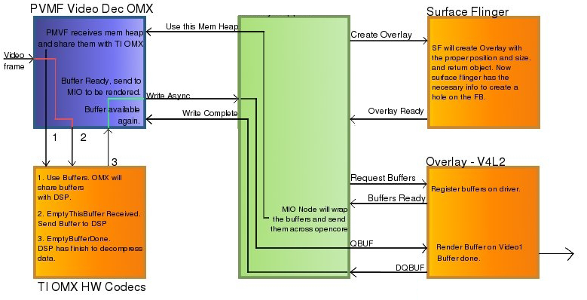
Android Multimedia
Rendering through Overlay Interface

Slide 47
Android Multimedia
Overlay Interface
1. Implement the stub funtions in hardware\libhardware\modules\overlay
\overlay.cpp, this will generate a share library liboverlay.trout.so.
2. In SurfaceFlinger, it will create a DisplayHardware instance, and
call DisplayHardware::init() which will create an overlay engine from
liboverlay.so.
3. When we want a OverlayRef from ISurface, we call
ISurface::createOverlay() which will take use of the overlay engine
create in step 2.
4. Create a Overlay from OverlayRef as it in frameworks\base\libs
\surfaceflinger\tests\overlays\overlays.cpp.
TI implementation to support overlay for the openCore video is available in: Hardwared/ti/omap3/libopencorehw/
http://git.omapzoom.org/?p=platform/hardware/ti/omap3.git;a=tree;f=libopencorehw;h=4b843e240897931c150f1a0cb25b1785c9e8dab2;hb=HEAD

Slide 48
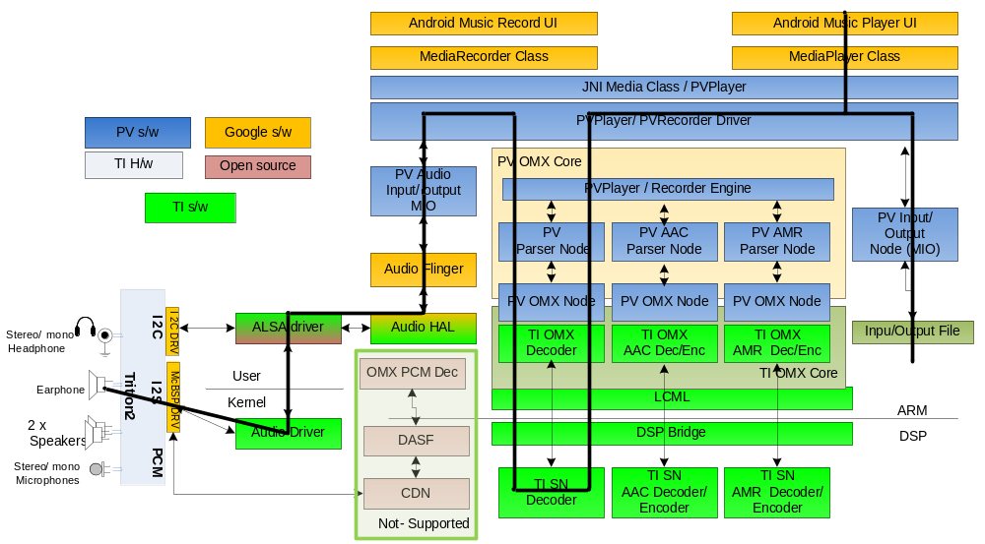
Android Multimedia
TI Audio Decode Architecture
AudioFlinger provides Audio Routing & Mixing Features.

Slide 49
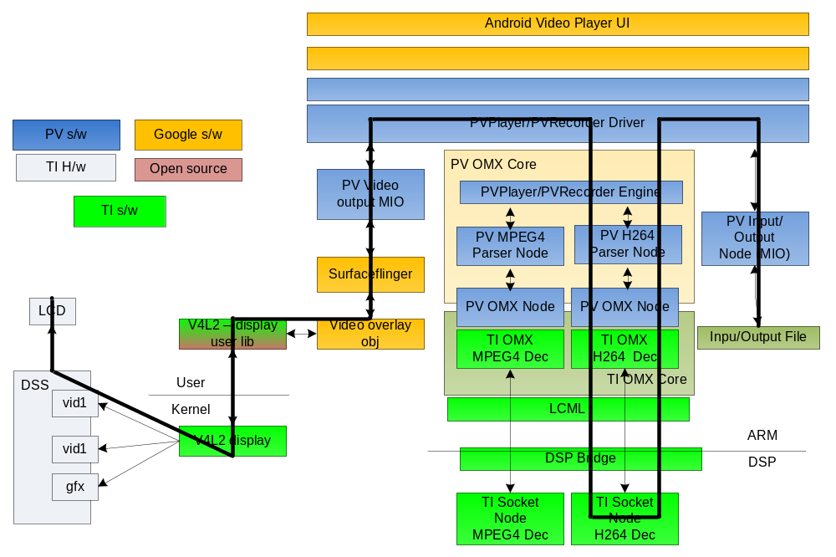
Android Multimedia
TI Video Decode Architecture

Slide 50
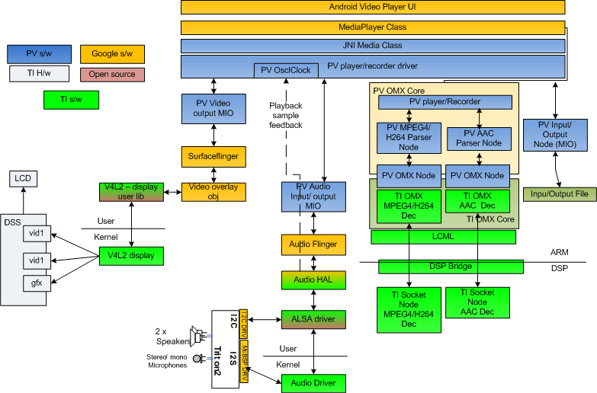
Android Multimedia
AV Sync

Slide 51
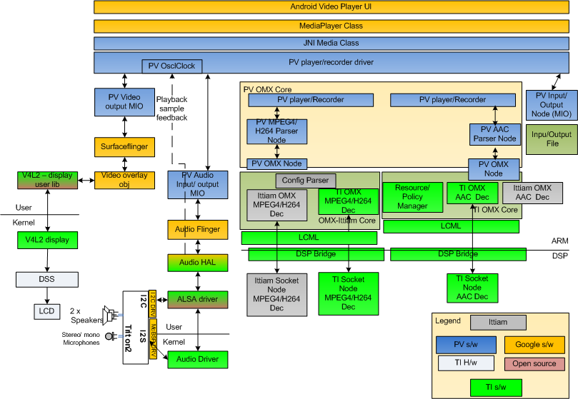
Android Multimedia
720 Split Codec Architecture
TI Proprietary Information – Strictly Private

Slide 52
Android Multimedia
720 Split Codec Architecture
Choice of Video Codec
  Config parser helps determine the video codec based on the video resolution
  Load Ittiam (split) codec if resolution is 720p, TI (DSP-only) codec if resolution is D1 or lower.
  Video codec OMX component registers it’s DSP MHz requirement with the OMX Resource Manager
Choice of Audio Codec
  OMX Core tries loading TI’s (DSP) audio codec first. If this fails, then it loads Ittiam’s (ARM) audio codec.
  Audio codec OMX component registers it’s DSP MHz requirement with the OMX Resource Manager
  If 720p video codec was loaded earlier, then DSP MHz are not available for TI audio codec. RM returns error, failing the loading of TI’s audio codec.
Requires Video Codec to be loaded before Audio Codec
  PacketVideo is evaluating this change to their Framework.

